Slide 1
Bradley International Finance Spring 2022
Transnational Financial Regulation: Financial Market Infrastructures

Slide 2
Why focus on payments systems and regulation?
The Libyan Arab Foreign Bank case involves issues about how US dollar payments are made (large value payments cleared through Fedwire or CHIPS)
Elliott Associates tried to recover funds in the hands of Euroclear
There are questions in the US NML Capital litigation about the implications of the court’s orders for payment systems
Understanding something about payments helps with some of the issues that arise in the context of sanctions measures

Slide 3
Payment systems regulation as an example of transnational financial regulation
Financial markets infrastructures, FMIs, including payments systems, are the plumbing of the international financial system: we don’t worry about it when it works, but it is a real problem if it breaks down.
From the perspective of financial regulation we worry about making sure that essential parts of the financial system don’t break down.
If we are not careful, risks can spread through the financial system.
See Principles for Financial Markets Infrastructures

Slide 4
How do we address risks that a solvency/liquidity problem of one participant in a payments system is not transmitted to other participants, and to their customers?
Interconnectedness is a financial stability issue.
Contagion involves worries about interconnectedness.
So we worry about risks both to address the risks and to address perceptions of risk.

Slide 5
Fedwire
Fedwire is a Federal Reserve Bank service.
Fedwire is a real time gross settlement system for US dollar payments.
Fedwire processes and settles payment orders individually throughout the operating day.
Payments are final and irrevocable when made
A bank that sends payment orders to Fedwire must have sufficient funds on deposit with a Federal Reserve Bank or sufficient overdraft capacity to meet the payment.

Slide 6
CHIPS
CHIPS is a private sector payment system owned by financial institutions, which are regulated banking entities.
The Financial Stability Oversight Council designated CHIPS as a systemically important financial market utility under the Dodd-Frank Act.
CHIPS is a real time net settlement system: payments between parties are netted against each other instead of the full dollar value of both trades being sent. During the day banks send and receive payments. CHIPS nets and releases payments. At the end of the day the CHIPS system eliminates credit limits, and releases and nets unresolved payments. Then CHIPS releases any remaining payments and sends payment orders to banks via Fedwire.
The average size of transactions is over US$3m.
It is slower and less expensive than Fedwire.
CHIPS Public Disclosure of Legal, Governance, Risk Management, and Operating Framework (June 2020)

Slide 7
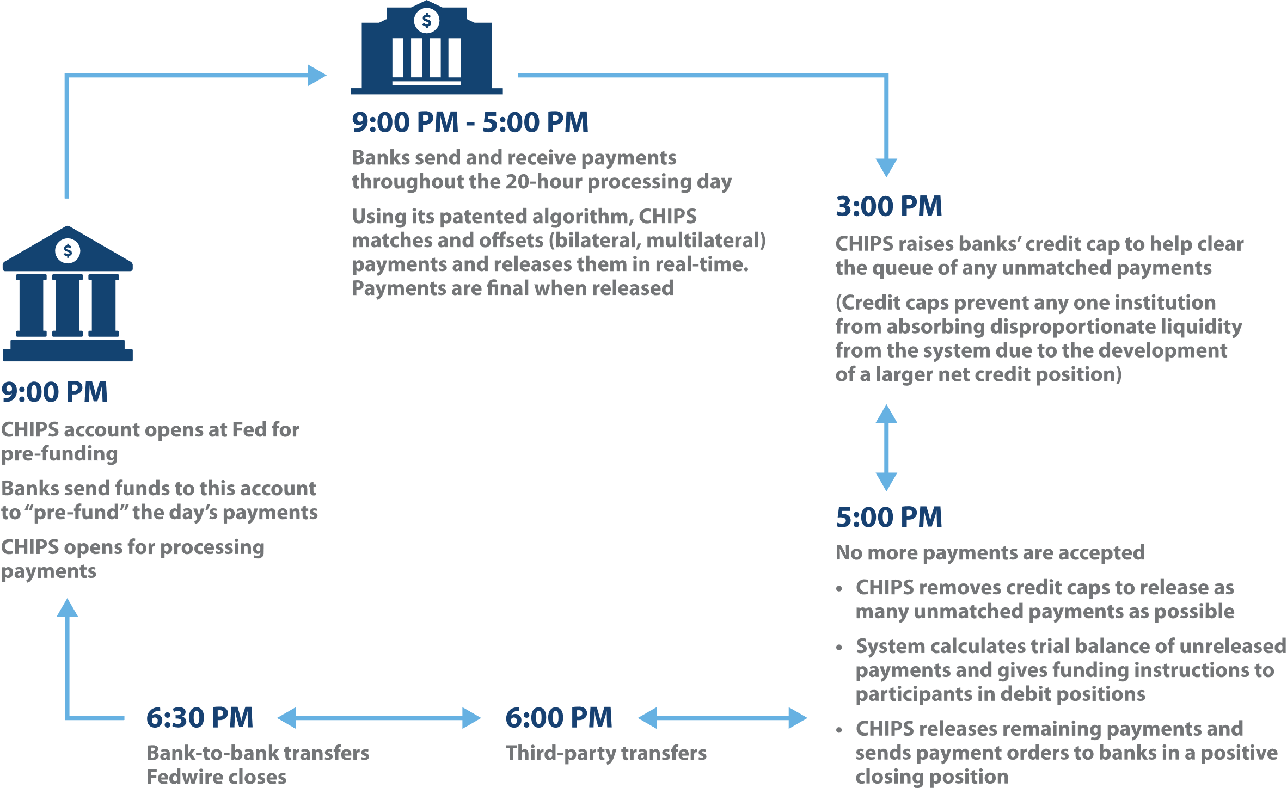

Slide 8
CHIPS continued
CHIPS and Fedwire compete. The CHIPS Payment Company is not a party to any transactions, and funds go through an account at the FRBNY.
“On an average day, CHIPS transmits and settles over 470,000 “payment messages” worth an aggregate of $1.6 trillion” (CHIPS Public Disclosure, cited above).
There are security procedures for authenticating payment messages which are not made public, and there is an algorithm which determines whether or not payments can be settled within CHIPS rules.
Parties can pre-fund a day’s payments and add funds during the day. CHIPS does not allow the release of payment messages that would put a participant into a negative position.

Slide 9
CHIPS Payment message information
Key Fields in a CHIPS Payment Message
A CHIPS payment message includes some or all of the following information:
• Value date
• Sending participant’s CHIPS identification number
• Receiving participant’s CHIPS identification number
• Dollar amount
• Intermediary bank identification
• Beneficiary’s bank identification
• Beneficiary identification
• Originator identification
• Originator’s bank identification
• Instructing bank identification
Other fields in the CHIPS payment message provide space for various parties to provide information to other parties to the funds transfer.

Slide 10
Risks in the CHIPS system
No credit risk.
No collateral because there is no credit risk.
There is a systemic financial risk from the fact that it is a net system.
There could be issues involving interruptions caused by technical issues or a funding failure by a participant.
Unreleased or expired payments messages could cause downstream credit and liquidity risks to banks expecting to receive payments.

